Slide 1
Declarative relations

Slide 2
Current situation
Relations are calculated in code (discovery plugins)
Advantages:
Flexibility: ability to express arbitrarily complex rules
Efficiency: ability to use the most efficient algorithm for specific tasks
Disadvantages:
Introspection: not self-describing (discovery is a black box)
Adaptability: not (easily) configurable
Solution: add a second, declarative mechanism

Slide 3
Goals
Allow codifying customer-specific conventions in relation rules
E.g. Relation between traced services and containers
Update these relations at a certain interval
From within relation-graph (with exclusive lock)
Simplest implementation
Okay if rules can run fast enough (i.e. not too many rules)
From an external process (using transaction support)
Would require running query in transaction

Slide 4
Example: service -> pod
Depending on current practice and available info:
Augment traces with fields from opentelemetry semantic conventions:
K8s.pod.uid (using env.valueFrom.fieldRef.fieldPath: metadata.uid)
K8s.container.name (fixed value)
Match image name with service name, service instance id with namespace
...

Slide 5
Rule definition
Definition: { Relation_type: “...”, Rules: { name: [{ Source: (pattern), Target: (pattern template) Properties: { Property: (property template) } }] } }
All relations of this type are defined (owned) by these rule (or add separate field to track ownership of relations)
Withing each rule group, the first matching rule counts

Slide 6
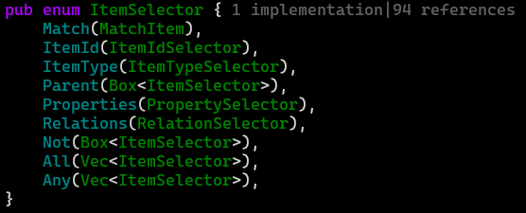
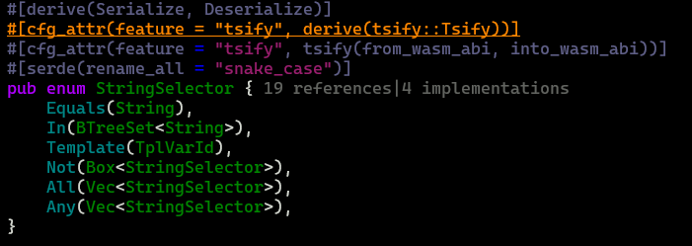
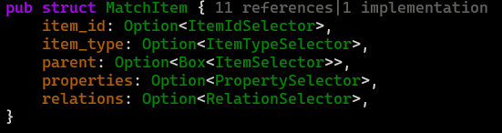
Source (pattern : ItemSelector)
Use existing ItemSelector from Query
Extend StringSelector with substring templates

Slide 7
Target (pattern template)
Template for an item selector
Allows using matched template variables in source item to match target item

Slide 8
Property template
Allows defining properties using matched template variables in source and target items

Slide 9
Trace service -> pod using semantic conventions
{ “relation_type”: “jaeger_k8s/runs_on”, “rules”: { “k8s”: [{ “source”: ..., “target”: ..., “properties”: {} }] } }

Slide 10
Source selector
{ “match”: { “item_type”: “jaeger/service”, “properties”: { “match”: { “jaeger/k8s_pod_uid”: { “template”: “pod_uid” }, “jaeger/k8s_container_name”: { “template”: “container_name” } }} }}

Slide 11
Target selector template
{ “match”: { “item_type”: { “equals”: “kubernetes/container” }, “parent”: { “match”: { “item_type”: { “equals”: “kubernetes/pod” }, “properties”: { “match”: { “kubernetes/uid”: { “equals”: “{pod_uid}” } }}
}}, “properties”: { “match”: { “kubernetes/name”: { “equals”: “{container_name}” } }} }}

